Slide 1
UI Basics 1
Guangjian Zhou

Slide 2
what is tag in HTML
HTML tags are the keywords on a web page that define how your web browser must format and display your web page.
Almost all tags contain two parts, an opening, and a closing tag

Slide 3
HTML stand for ?
Hypertext Markup Language

Slide 4
List Any 20 Tags in HTML
Unclosed HTML Tags
Some HTML tags are not closed, for example br and hr.
<br> Tag: br stands for break line, it breaks the line of the code.
<hr> Tag: hr stands for Horizontal Rule. This tag is used to put a line across the webpage.
HTML Meta Tags
DOCTYPE, title, link, meta and style
HTML Text Tags
<p>, <h1>, <h2>, <h3>, <h4>, <h5>, <h6>, <strong>, <em>, <abbr>, <acronym>, <address>, <bdo>, <blockquote>, <cite>, <q>, <code>, <ins>, <del>, <dfn>, <kbd>, <pre>, <samp>, <var> and <br>
HTML Link Tags
<a> and <base>
HTML Image and Object Tags
<img>, <area>, <map>, <param> and <object>
HTML List Tags
<ul>, <ol>, <li>, <dl>, <dt> and <dd>

Slide 5
What is UL tag
Definition and Usage. The <ul> tag defines an unordered (bulleted) list. Use the <ul> tag together with the <li> tag to create unordered lists. Tip: Use CSS to style lists.

Slide 6
What is DIV tag
The <div> tag defines a division or a section in an HTML document.
The <div> tag is used as a container for HTML elements - which is then styled with CSS or manipulated with JavaScript.
The <div> tag is easily styled by using the class or id attribute.
Any sort of content can be put inside the <div> tag!
Note: By default, browsers always place a line break before and after the <div> element.

Slide 7
How to Create form in HTML.
<form> . form elements . </form>

Slide 8
What is TAble tag ,Show working.
HTML Table
HTML table tag is used to display data in tabular form (row * column). There can be many columns in a row.
We can create a table to display data in tabular form, using <table> element, with the help of <tr> , <td>, and <th> elements.
In Each table, table row is defined by <tr> tag, table header is defined by <th>, and table data is defined by <td> tags.
HTML tables are used to manage the layout of the page e.g. header section, navigation bar, body content, footer section etc. But it is recommended to use div tag over table to manage the layout of the page .

Slide 9
What is href and Anchor Tag.
<a>: The Anchor element
The <a> HTML element (or anchor element), with its href attribute, creates a hyperlink to web pages, files, email addresses, locations in the same page, or anything else a URL can address.
Content within each <a> should indicate the link's destination. If the href attribute is present, pressing the enter key while focused on the <a> element will activate it.

Slide 10
How to Add image in HTML page example.
<img src="pic_trulli.jpg" alt="Italian Trulli">

Slide 11
What is CSS.
CSS (Cascading Style Sheets) allows you to create great-looking web pages, but how does it work under the hood? This article explains what CSS is with a simple syntax example and also covers some key terms about the language.

Slide 12
Show woring of Inline CSS
Associate styles with your HTML document using methods inline CSS and External CSS.
You can use style attribute of any HTML element to define inline style rules. These rules will be applied to that element only. Here is the generic syntax:
<element style = "...style rules....">

Slide 13
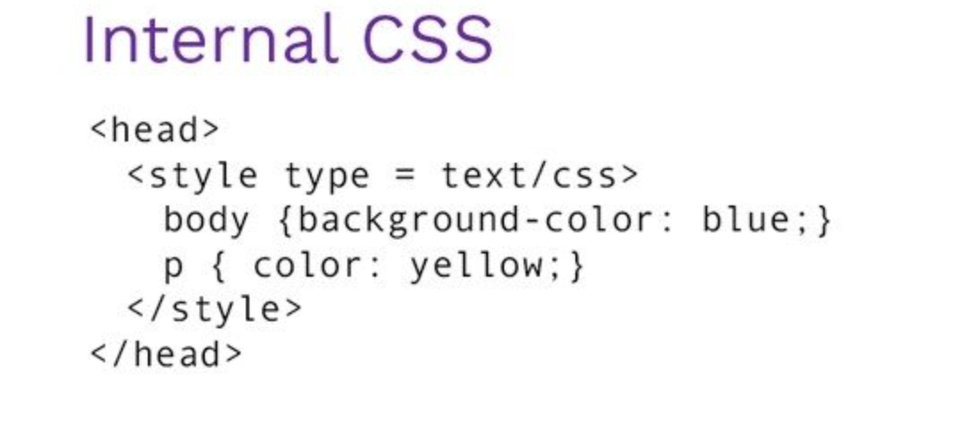
Show working of Internal CSS.

